Slide 1
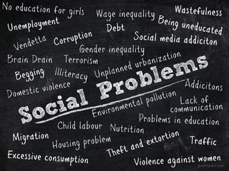
Socio-political knowledge
Week 2: Introduction to the concept of social problems

Slide 2
What is a social problem?
A condition that:
affects large numbers of people in a society, and
is generally recognised to be harmful or undesirable.

Slide 3
What implicit claims are made when we say that something is a social problem?
Something is fundamentally wrong
It affects a large number of people
The situation can be changed through human intervention
Someone should intervene to change the situation

Slide 4

Are these things social problems?
Explain your decisions using the ‘implicit claims’ you wrote in your lecture notes:
Gambling addiction
Earthquakes
High divorce rates
Stress among students
Population decline (in a country)
Social media use

Slide 5
Give some examples of social problems commonly studied by sociologists.
Poverty and inequality
Crime and anti-social behaviour
Domestic violence and sexual abuse
Addictions (alcoholism, drug addiction etc.)
Discrimination (by gender, ethnicity, religion etc.)

Slide 6

What (in your opinion) are the most serious social problems in Kazakhstan? (Your subjective opinion, but give reasons)
In your teams, decide on the ‘top 3’ most serious social problems in KZ

Slide 7
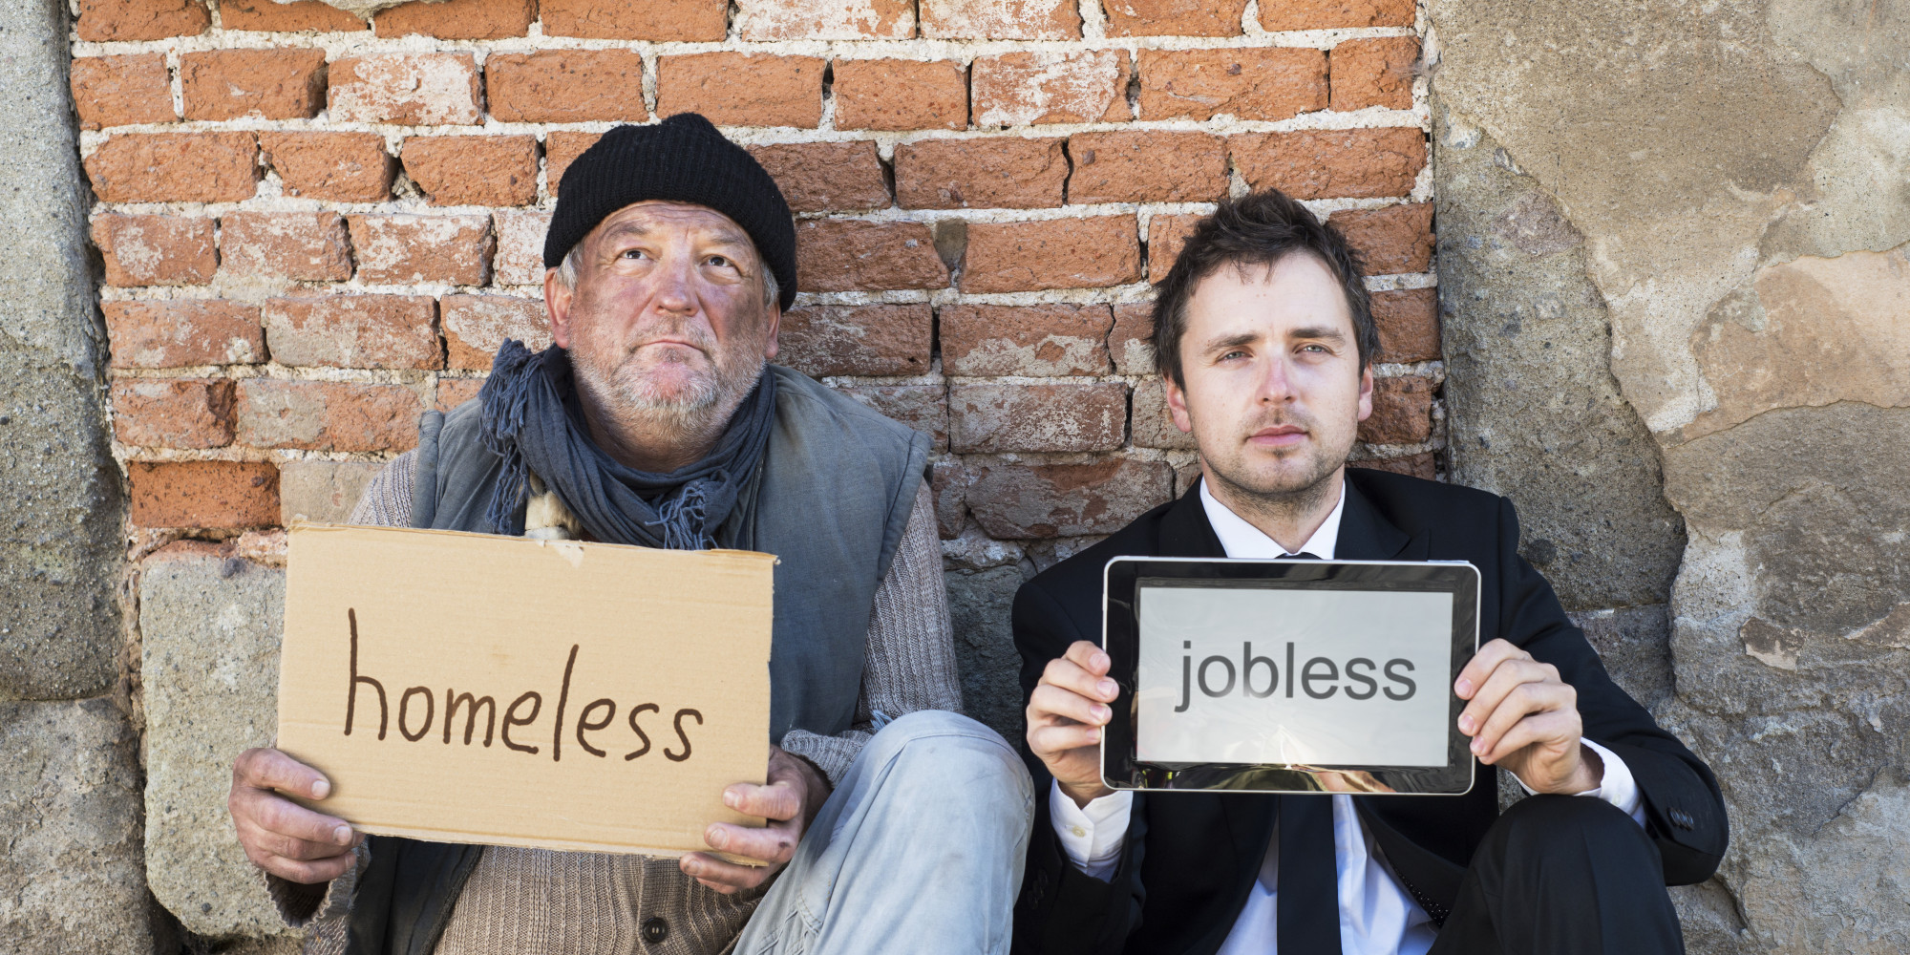
What is the objectivist approach to social problems?
Analysing the situation itself
Collecting statistics on it
Working out what can be done to improve the situation

Slide 8

What is the social constructionist approach to social problems?
Analysing how and why society defines this situation as a problem
Social constructionists: “A condition only becomes a social problem when it is defined as one by society.”

Slide 9
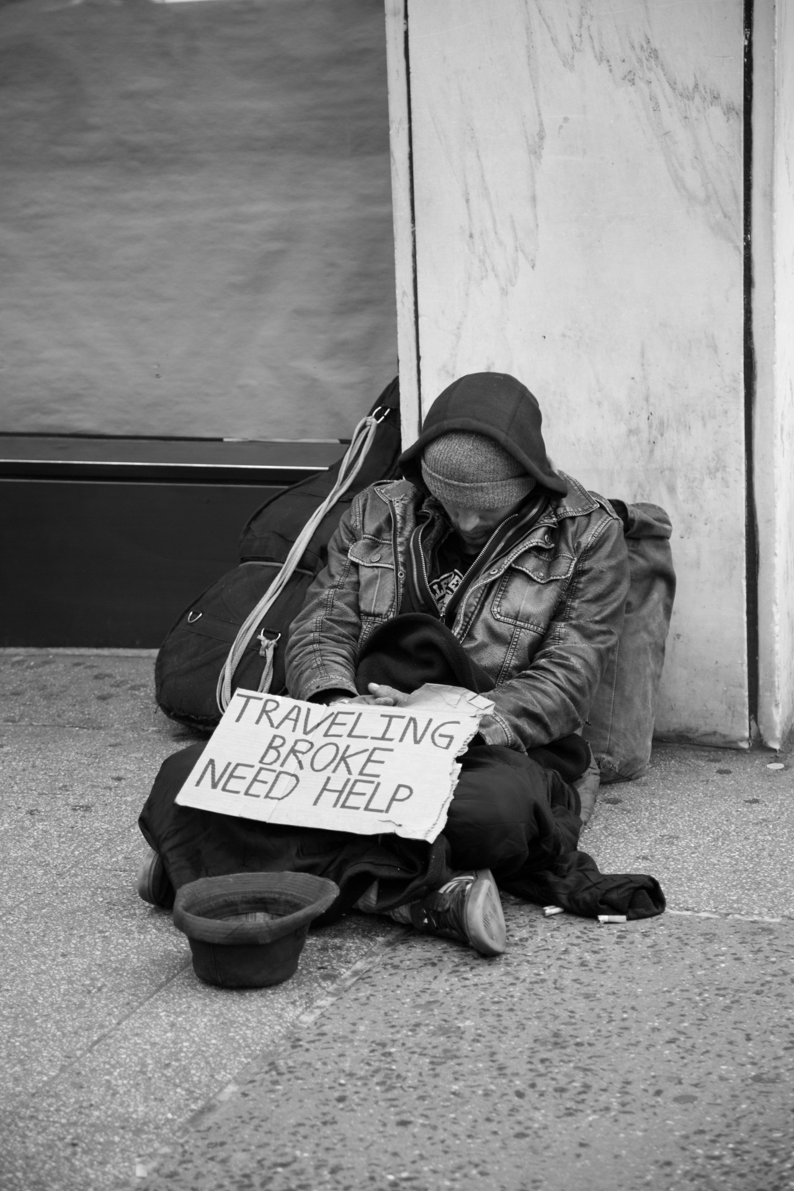

The difference between objectivist and social constructionist approaches
Objectivist: looks at the situation itself (i.e. objective conditions)
Social constructionist: looks at society’s reaction to the situation

Slide 10
X is a social problem…
Objectivist approach
Social constructionist approach
A. Looks at the harms people suffer from X.
C. Looks at which societal actors say X is a problem.
B. Looks at what causes X.
D. Looks at which different social groups suffer most from X (e.g. men/women, social class, young/old).
G. Looks at when society started to regard X as a problem requiring action.
D. Looks at what action policymakers are taking to address X.
E. Looks at what policy measures could improve X.
F. Looks at how different people define X.
H. Looks at public opinion about X.

Slide 11
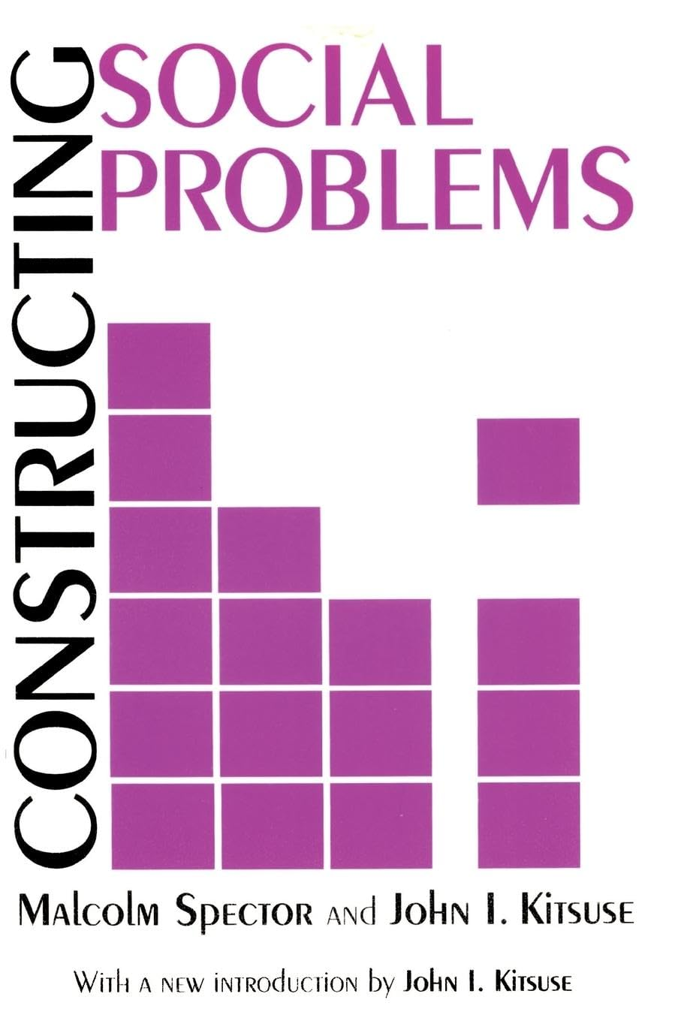
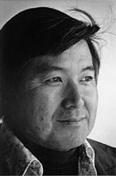
Which two sociologists gave the classic statement of social constructionism in their book Constructing Social Problems (1977)?
Malcom Spector and John Kitsuse

Slide 12
What are some key research questions that objectivist approaches to social problems try to answer?
What causes X?
Who is harmed by X?
What harm do they suffer?
What can be done to reduce X?

Slide 13
What are some key research questions that social constructionist approaches to social problems try to answer?
How did X come to be defined as a social problem?
Why was X defined as a social problem at a certain time – why not earlier/later?
Who were the main actors pushing for X to be defined as a social problem? Why were they successful?

Slide 14
What do claims-makers do? What types of societal actors act as claims-makers?
Claims-makers are individuals or groups who actively work to define a condition as a social problem.
Common examples of claims-makers:
Social movement activists
Scientists (including social scientists)
The mass media
Politicians

Slide 15
Explain what is meant by ‘problematisation’.
How objective conditions are said by claims-makers to represent a social problem.
IN WHAT RESPECTS is it a problem?
FOR WHOM is it a problem?
E.g. smoking could be problematised in different ways:
Smokers get ill and die (bad for the smokers)
Passive smoking causes illness in non-smokers (bad for non-smokers)
The state will have to spend more money on healthcare for ill smokers (bad for the state)
People throw their cigarette ends on the ground and make the public spaces look dirty (environmental problem)
People throw away cigarette ends in forests and cause fires (public safety problem)

Slide 16

Group task
In your teams, choose a serious social problem in Kazakhstan. Prepare answers to the following questions.
Imagine you are a researcher who wants to research this social problem:
Write 3 research questions about this problem from an objectivist perspective [you do not need to answer the questions!]
Write 3 research questions about this problem from a social constructionist perspective [you do not need to answer the questions!]
Who are some claims-makers who are trying to get this issue recognised as a social problem?
How do they problematise the issue?
What solutions do they propose?

Slide 17
How can culture affect perceptions and definitions of social problems?
Differences between collectivist and individualist societies
E.g. in an individualist society poverty might be seen as the individual’s own fault/responsibility, and therefore might not be perceived as a social problem.
Cultural norms affect whether something is seen as a problem
E.g. Excessive alcohol consumption – can be seen as socially acceptable behaviour or deviant behaviour depending on the culture.
E.g. In patriarchal societies discrimination or violence against women might be seen as acceptable.

Slide 18
Why is it important to take account of the local culture when designing and implementing policy interventions to address social problems?
Policy interventions will not be effective if they do not take account of people’s culturally-determined values, norms and beliefs.
Policy interventions try to get people to change their behaviour, but this is only possible if we take account of their cultural mindset. If the policy intervention clashes with local cultural norms or values, people will resist it.
Solutions that work in one cultural context may not be appropriate or accepted in another.

Slide 19
Think of as many different ways as possible that high alcohol consumption in a society could be problematised.
Public health problem (alcohol causes health problems)
Law and order problem (drunk people commit more crimes)
Poverty problem (people spend money on alcohol instead of essentials)
Economic problem (drunk/hungover people miss work and are less productive)
Road safety problem (drink driving)
Child neglect problem (drunk parents neglect their children)

Slide 20

What is deviance?
Deviance = behaviour that violates social norms
Deviance is culturally relative. A behaviour seen as completely unacceptable in one society may be tolerated—or even celebrated—in another.
Can you think of some examples of behaviour that is considered deviant in one society but not in another?

Slide 21

What is crime?
Crime = behaviour that is against the law

Slide 22
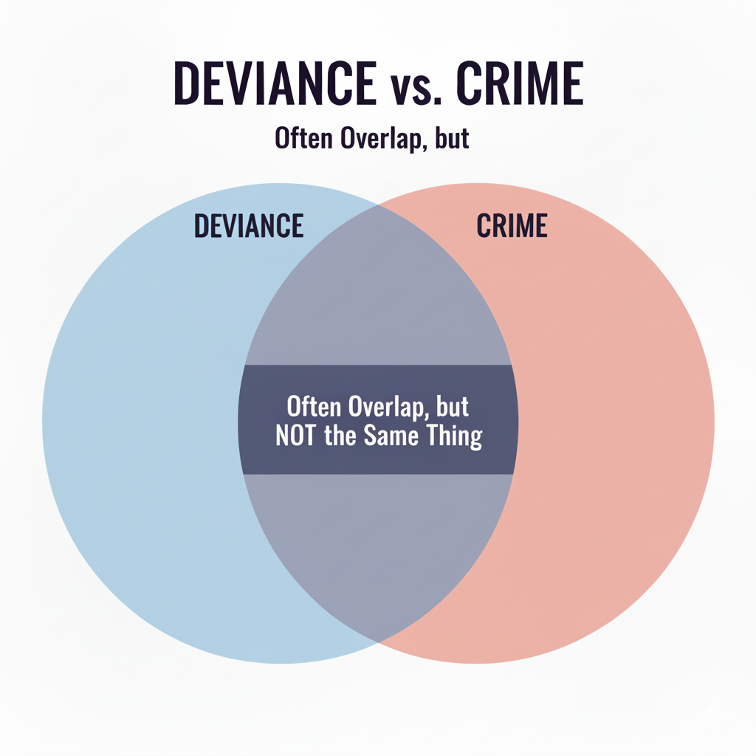
What is the relationship between deviance and crime?

Slide 23
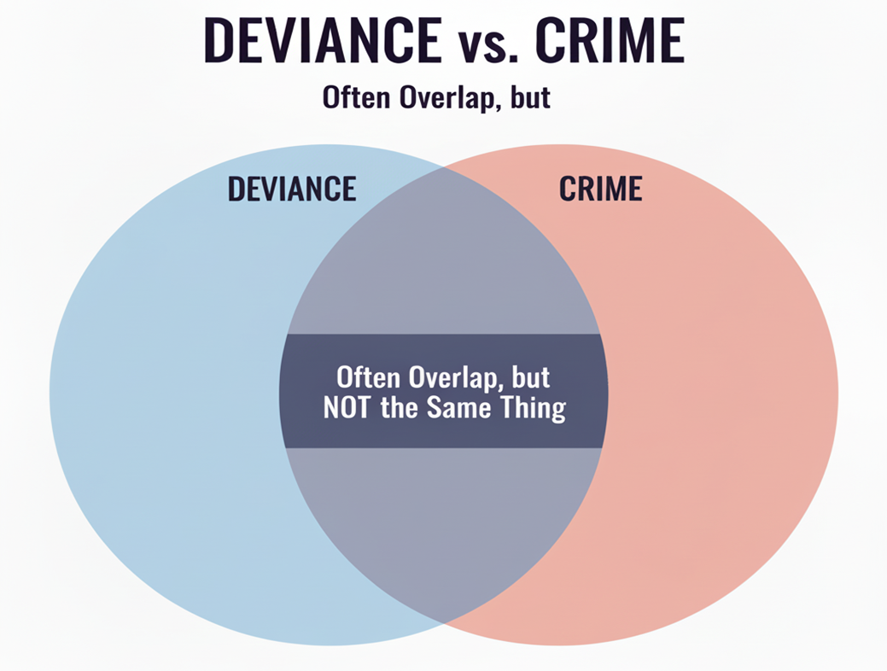
What is the relationship between deviance and crime?
Many forms of deviance are criminalized, i.e. made illegal by the state. E.g. murder, theft.
However, not all deviance is crime. E.g. dressing in an unusual way, having face tattoos.
Not everything illegal is seen as deviant. E.g. stealing printer paper from work to use at home.

Slide 24

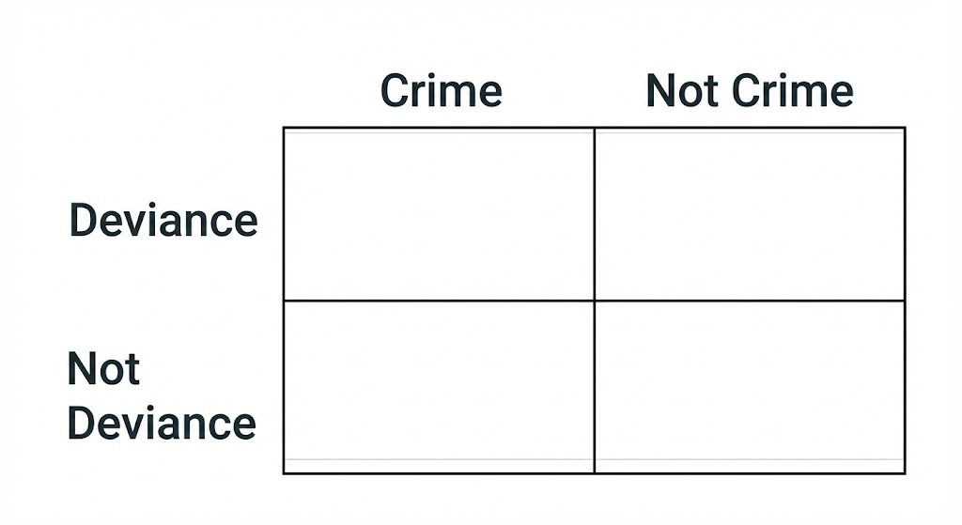
Deviance and Crime in Kazakhstan
Think of TWO examples for each section of the table, from the perspective of Kazakhstani society

